Slide 1
Building Better Opportunities
June 2017
Financial Claim Session

Slide 2
Financial Compliance
Heavy Scrutiny
Financial Repercussions
Notes:
Hello my name is Catherine Pritchard, one of the funding officers who works on BBO - I am here today to talk about the financial side of your claim.
Most of you will have already submitted a claim or will be starting to pull your evidence together to submit one. I can’t stress the importance of ensuring that your claim meets the specific requirements that EU funding brings. Failure to comply with these requirements could have serious financial repercussions for you and your partners.
You may think we are being pedantic at times and yes I agree, but ESF funding is pedantic and we want to ensure, risk of clawback, to you and to us is reduced. I don’t like having to go back to people for more and more information, but honestly, and it is in your best interest. Your claim will be open to scrutiny not only from us, the DWP and the European Commission but also from a range of other agencies which are listed within the terms and conditions of your grant (T&C 6.9).
We have now reviewed, up to 3 claims for some grant holders therefore a picture is emerging of the common challenges and frustrations. By sharing these with you we and supporting you to learn from each other hope to minimise the risk of them occurring again in the future.
We have already circulated lessons learned from the previous claim period, and there are webinars compiled by our support contractors available on how to pull together a compliant claim. Please if you haven’t already, review this material and even if you have, it would do no harm to revisit it. I’m not going to repeat everything contained within these today - instead I would like to focus on what we have found to be the four most common issues.
After we can break into groups to discuss them, possible ways around them, share learning from and if we have time feed back to wider group.

Slide 3
Actual Cost
Annexes
Defrayal
Direct/Indirect Costs
Lead Partner Responsibilities
Notes:
On the screen we have set-out what we think are the main challenges we have seen in financial claims we have reviewed to date:
You will see that ‘actual costs’ is at the centre – this is because we have found all of the others seem to stem from it being an actual cost programme as opposed to payment by results which is more common in European Funding.
The other four areas are: defrayal, direct/indirect costs, lead partner responsibility and annexes.
I will now discuss each of these and why they have proved problematic claims reviewed to date.

Slide 4
ACTUAL COST
BBO ESF Support Webinar on Actual Costs
https://www.bboesfsupport.com/actual-costs-webinar-1
Notes:
Actual costs
I don’t want to go into the detail of what actual costs is – hopefully you should already know this and there is an excellent webinar already available on our support website. I would urge you to review this.
What I do want to highlight that as an actual cost programme BBO is different to other ESF programmes that you may have worked on in the past - on this point, it is worth noting that even if you delivered ESF funding in the past it does not mean the same rules and regulations apply for BBO.
In practical terms actual cost means you must have an audit trail for every financial transaction showing the transaction for the good/service through to the point it leaves an organisation bank account. This applies to all leads and partners.
A common issue has been partners submitting invoices for a service without demonstrating the actual cost that sits behind that invoice. This is not ESF compliant under an actual cost program and therefore not acceptable.
One further point - we assume that only compliant ESF costs are put in your budget and we award grants subject to the rules and regulations of ESF funding.

Slide 5
Defrayal
All partners need to show evidence from their bank account that payments have been made, as well as the original invoice
Notes:
This brings us neatly onto defrayal.
As we have just discussed - all partners need to show evidence from their bank account that payments have been made, as well as the original invoice.
If this, for example, includes salaries paid as part of a BACS or payroll run that shows a single payment for all salaries on the bank statement – we also need to see the BACS or payroll report linking the specific payment to the individual to the total value shown on the bank statement.

Slide 6
Direct/ Indirect Costs
Direct costs are directly related to a project activity such as staff salaries
Indirect costs cannot be directly connected to a specific project activity
* Indirect costs 15% of direct staff costs
Notes:
Now looking at direct and indirect costs.
If your considering if a cost is a direct or indirect the defrayal evidence can help.
Direct costs are directly related to a project activity such as staff salaries – and can easily be shown as a single cost you can easily show is specifically for the project.
Indirect costs cannot be directly connected to a specific project activity – if you are struggling to show the defrayal evidence linking specifically to a BBO project activity.
Please remember your being paid 15% of your direct staff costs to cover your indirect costs, you do not need to show any evidence for this.

Slide 7
Indirect Costs
Shared support services, HR
Overheads, electricity, telephone
Generally anything you would expect to apportion
Notes:
This slide highlights some examples of potential indirect costs.
These are:
Shared support services, HR
Overheads, electricity, telephone
Generally anything you would expect to apportion
We have come across on a number of occasions is an organisation creating an invoice/ internal recharge to themselves for BBO costs, the problem with this, is that there is no audit trail, how do you demonstrate defrayal?
Also how does an organisation demonstrate it’s not making a profit on it?
(If questioned on this remember we are meeting with MA to discuss specific examples of apportionment/recharge )

Slide 8
Leads Responsibility
It is your responsibility to support all partners to understand what they are signing up to i.e. the rules and regulations of the programme
It is your responsibility to check everything that is sent to you, by a partner, before submitting your claim to us
Notes:
Make reference to the grant holder presentation and the good examples they provided
Remember, as leads:
It is your responsibility to support all partners to understand what they are signing up to i.e. the rules and regulations of the programme
It is your responsibility to check everything that is sent to you, by a partner, before submitting your claim to us
We are seeing some instances where partners do not understand the ESF requirements, largely related to evidential requirements of actual costs and have substantially underestimating the management and administration time involved. Particularly for some smaller partners, this has led to them pulling out of the partnership.
This is something I would like to discuss in our break out session perhaps sharing with one another what you have found to work well in communicating with your partnership ESF requirements. What support do you give your partners, to understand their requirements and how do you tailor this to their needs?

Slide 9
Annexes
Notes:
Annexes have become a bit of a mute topic within BLF offices, we really appreciate your support in our attempts to get this right. We are working hard to ensure these fit the changing requirements of the MA and respond to customer feedback. Please bear with us. I just want to use this opportunity to highlight a couple of issues we would like your help with….

Slide 10
We are transferring on to a new Annex A which should make re profiling easier.
Annex A & O must balance
Only input data to the nearest penny, as the rounding issues causes Annex A & O not to balance
If copying & pasting, be careful, for example, copying a formula, from a partners Annex causes havoc in the final Annex to us
Description in Annex O, should be clear, remember it should be able to withstand an audit in 10 years time.
Clearly explain, any discrepancies in forecast and actuals in your annex B
Annex D should clearly explain any re profiling
Notes:
Read the slide
I think I have spent enough time talking about the main trends we have found in the claims to date. Now I would like to find out about any issues that are different to what I have already discussed. Depending on the response I would then like to split you up into two groups to discuss solutions, shared learning of approaches to the 2 or 3 most popular issues

Slide 11
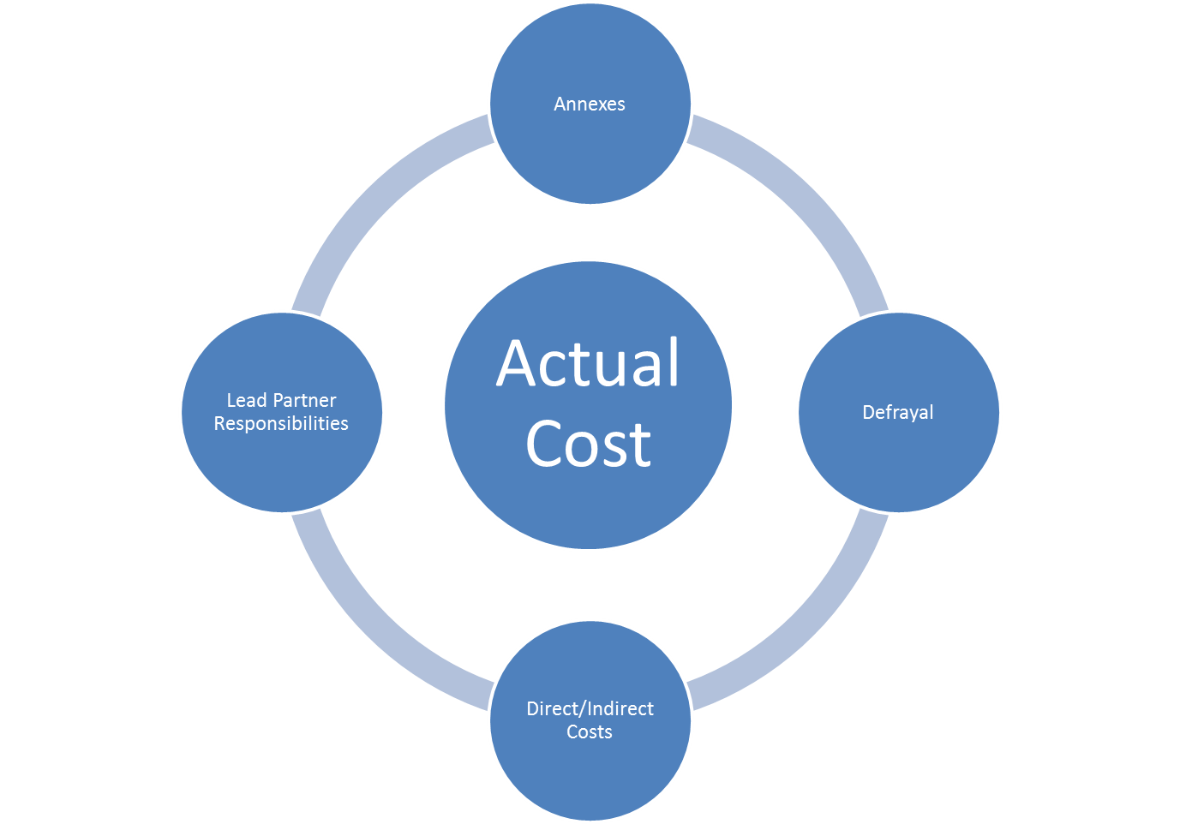
DISCUSSION
Notes:
I think I have spent enough time talking. I would now like each table to discuss each of these points defrayal, direct/indirect costs, lead partner responsibility and annexes – considering what you have done to overcome these issues and share what you have found does (and doesn’t) work. We don’t want to be too prescriptive here – this is a chance for you to learn from each other.
I would also like you, in your groups, to note whether there any other key points that you think have come out of your experience of financial claims to date that we have not covered here.
We’ll then come back together to share what you have discussed in each area, as well as taking any additional points. We don’t really want to get into specific questioning but if there is anything please pop it on a post it note and we will gather these at the end and will follow up with a response which will be circulated after these events.

Slide 12
Resources Available
https://www.bboesfsupport.com/ - Range of webinars ranging from claim submission webinar to actual cost
November Newsletter summarising claims feedback
Guide to delivering European Funding (England only)

